Slide 1

EDA-SQL(Customer orders analysis)
srividya

Slide 2
introduction
A comprehensive collection of SQL scripts for data exploration, analytics, and reporting. These scripts cover various analyses such as database exploration, measures and metrics, time-based trends, cumulative analytics, segmentation, and more.
This Projects contains SQL queries designed to help data analysts and BI professionals quickly explore, segment, and analyze data within a relational database. Each script focuses on a specific analytical theme and demonstrates best practices for SQL queries.

Slide 3

Performed EDA Project based on different categories as follows:-
- 1.Database Exploration
- 2.Dimensions Exploration
- 3.Date Exploration
- 4.Measures Exploration
- 5.Magnitude
- 6.Ranking Analysis

Slide 4
1. Database Exploration
Purpose:
- To explore the structure of the database, including the list of tables and their schemas.
- To inspect the columns and metadata for specific tables.
Table Used:
- INFORMATION_SCHEMA.TABLES
- INFORMATION_SCHEMA.COLUMNS

Slide 5
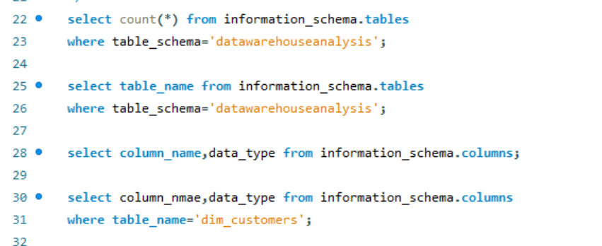

Slide 6
2. Dimensions exploration
Purpose:
- To explore the structure of dimension tables.
SQL Functions Used:
- DISTINCT
- ORDER BY

Slide 7
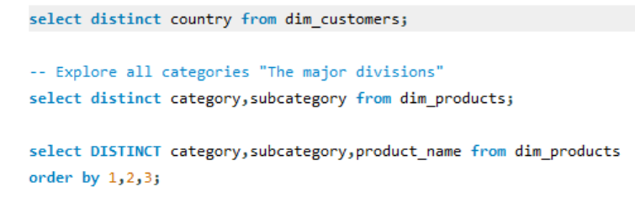

Slide 8
3. Date range exploration
Purpose:
- To determine the temporal boundaries of key data points.
- To understand the range of historical data.
SQL Functions Used:
- MIN(), MAX(), TIMESTAMPDIFF()

Slide 9
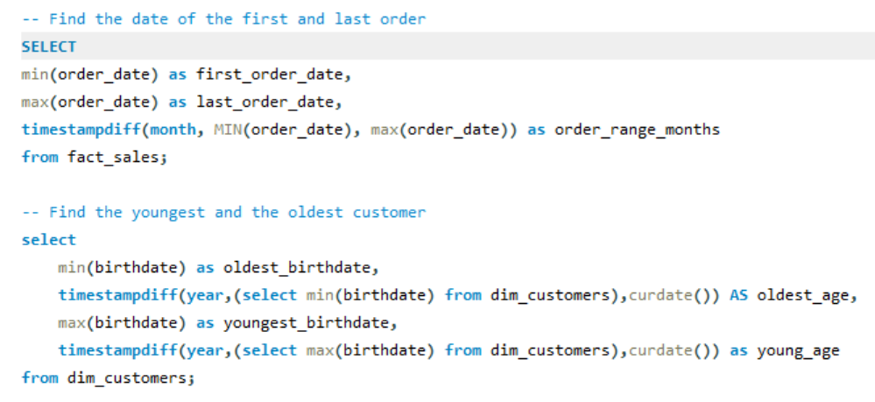

Slide 10
4. Measures exploration
Purpose:
- To calculate aggregated metrics (e.g., totals, averages) for quick insights.
- To identify overall trends or spot anomalies.
SQL Functions Used:
- COUNT(), SUM(), AVG()

Slide 11
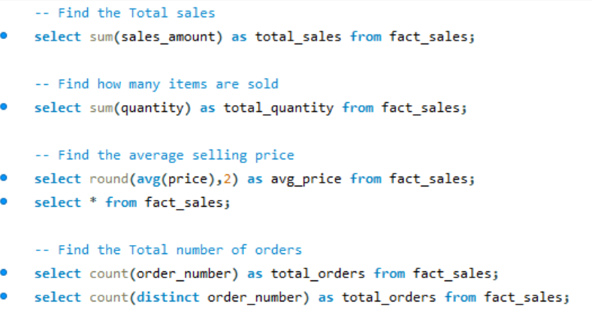

Slide 12
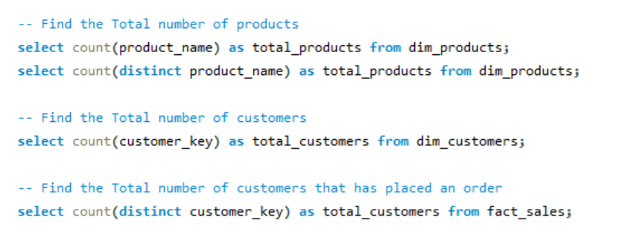

Slide 13
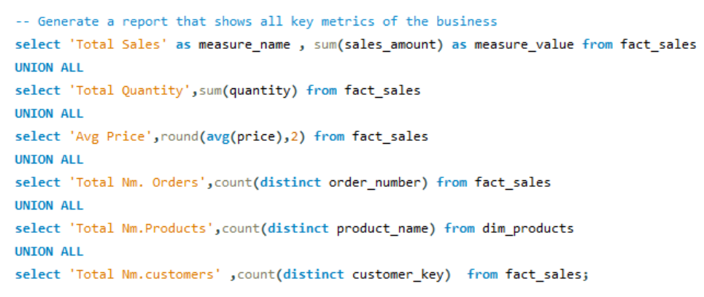

Slide 14
5. Magnitude
Purpose:
- To quantify data and group results by specific dimensions.
- For understanding data distribution across categories.
SQL Functions Used:
- Aggregate Functions: SUM(), COUNT(), AVG()
- GROUP BY, ORDER BY

Slide 15
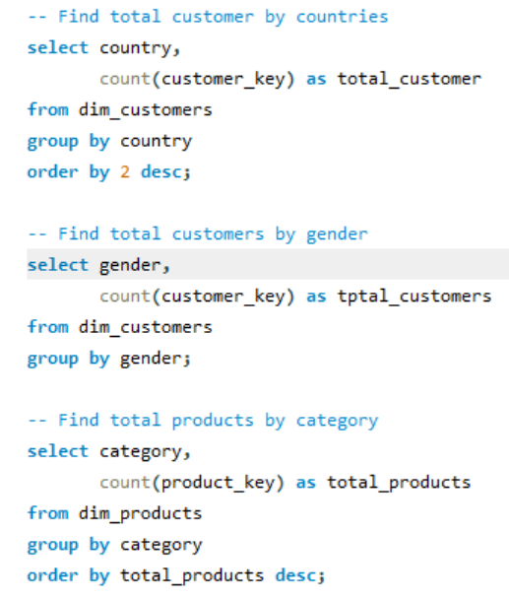
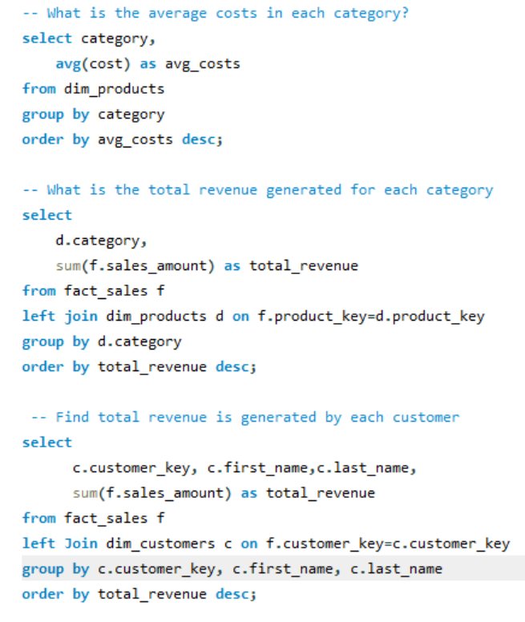

Slide 16
6. Ranking Analysis
Purpose:
- To rank items (e.g., products, customers) based on performance or other metrics.
- To identify top performers or laggards.
SQL Functions Used:
- Window Ranking Functions: RANK(), DENSE_RANK(), ROW_NUMBER(), LIMIT
- Clauses: GROUP BY, ORDER BY
- CTE

Slide 17
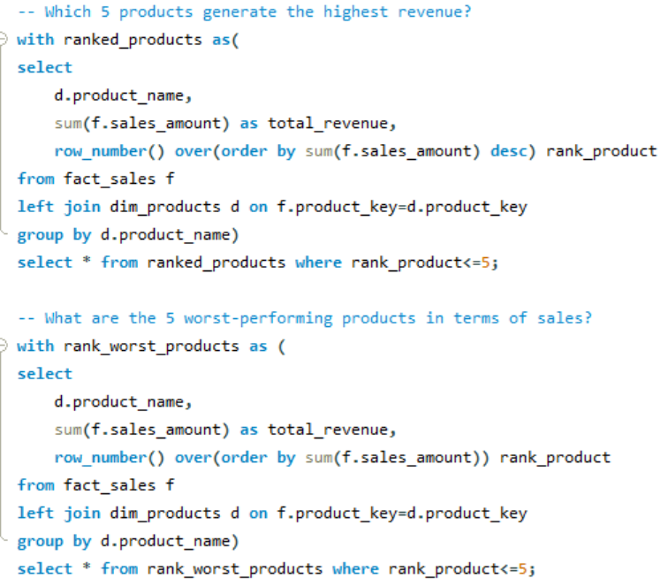
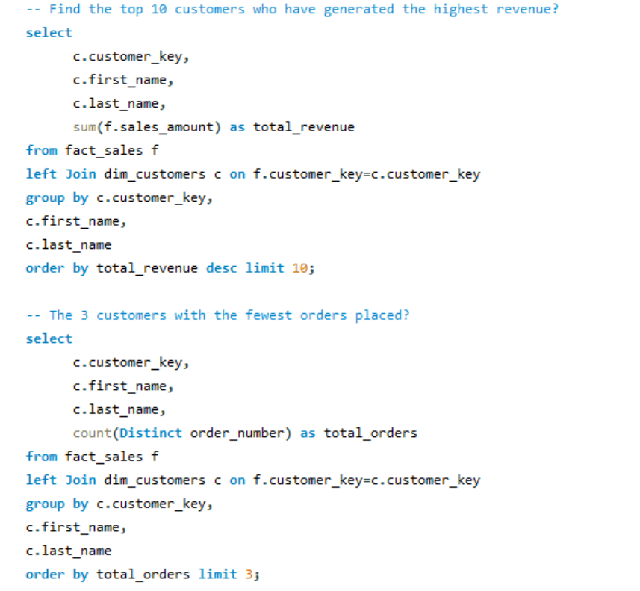

Slide 18
conclusion
"This project demonstrates the power of SQL in analyzing customer order data. By using advanced queries, we explored database structures, calculated key metrics, analyzed trends, and ranked entities to extract valuable insights. These analyses help businesses make data-driven decisions to improve performance and customer experience."

